Slide 1
Wetterstation mit datenbank und webseite
Von Simon Garb

Slide 2
Inhaltsverzeichnis
Hardware
Der Arduino
Der ESP8266
Datenbank
API-Controller
Webseite

Slide 3

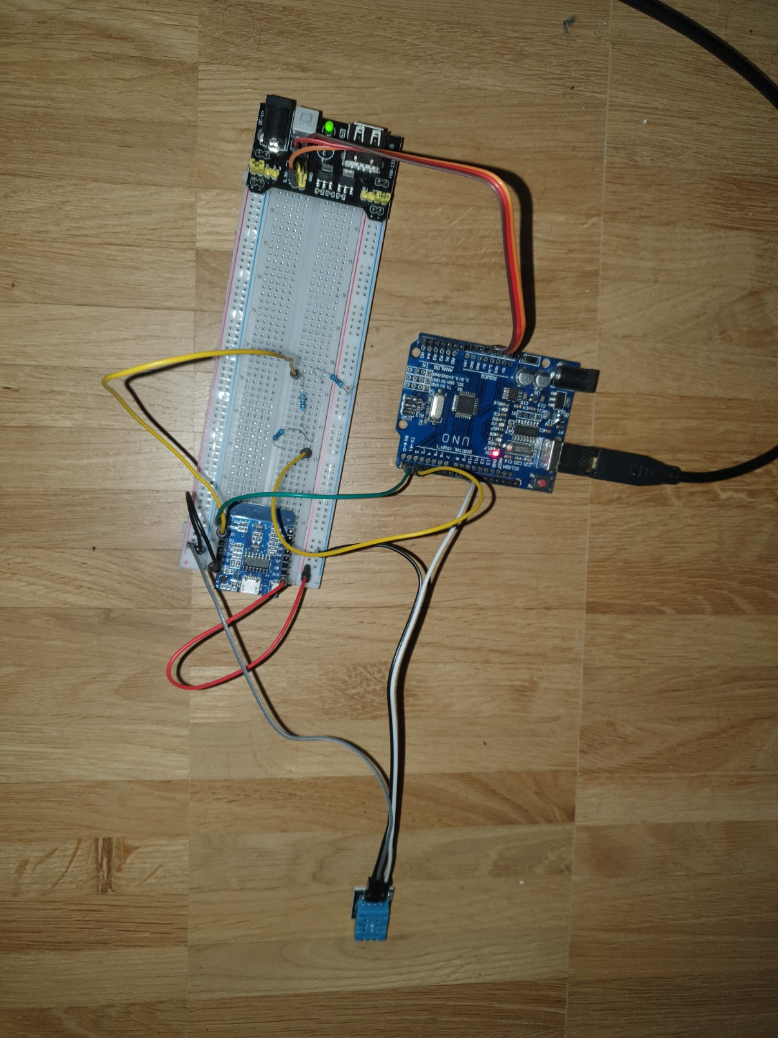
Hardware
Arduino uno R3
ESP8266
Temperatur und Luftfeuchtesensor
Widerstände für Spannungsteiler
Breedboard

Slide 4
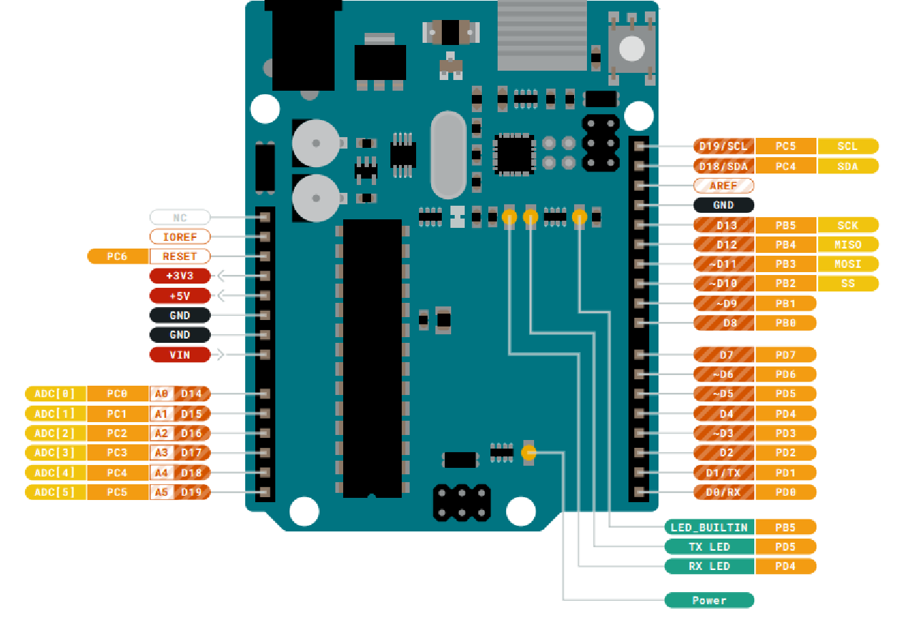
Arduino
Sensor Daten Pin9
ESP8266 RX/TX
Spannungsversorgung über 5V, 3v3
Arduino UNO R3
ATmega328P 16MHz

Slide 5
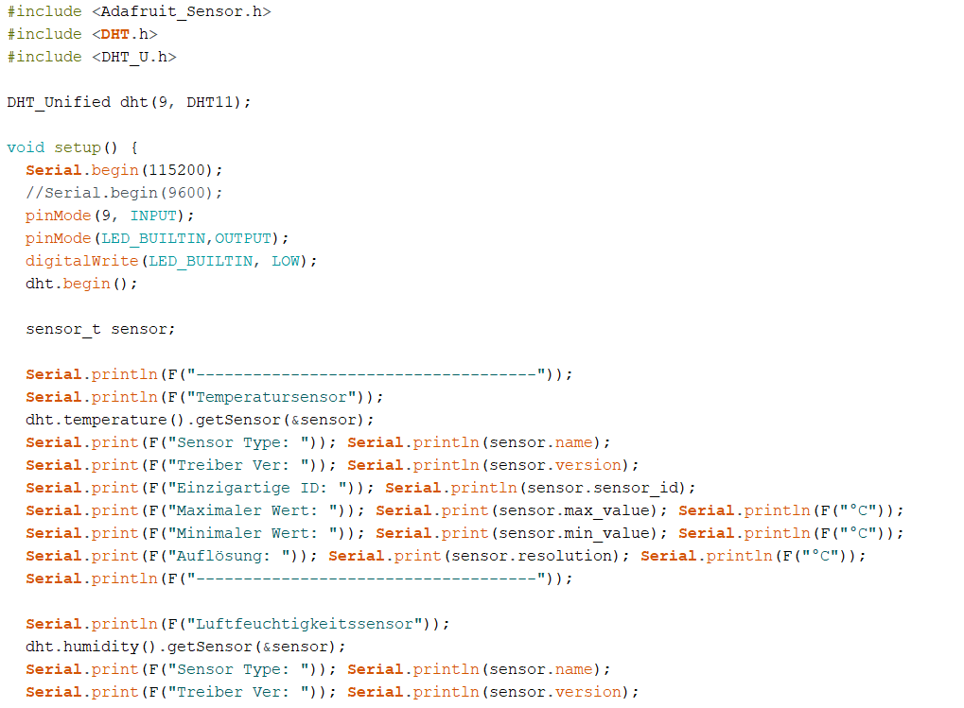
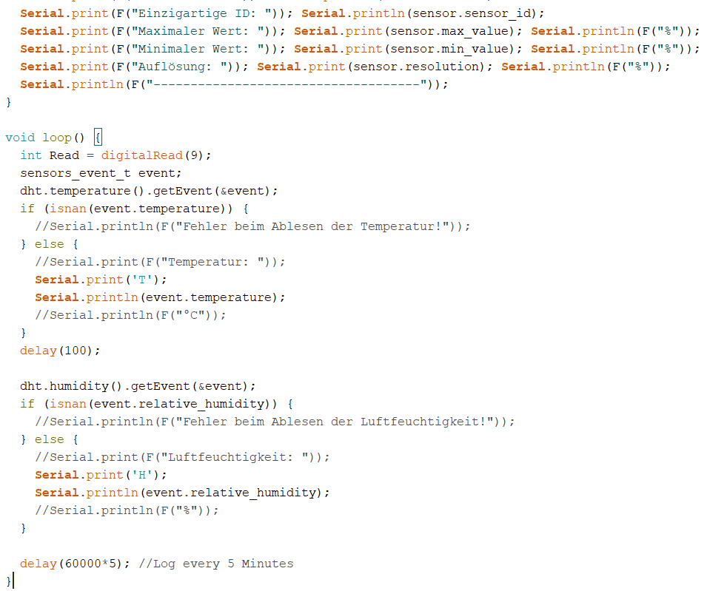
Arduino
Notes:
DHT11: Sensortyp
sensor_t ist ein Datentyp, der Sensoreigenschaften (Name, Auflösung, Max/Min-Werte etc.) enthält.

Slide 6
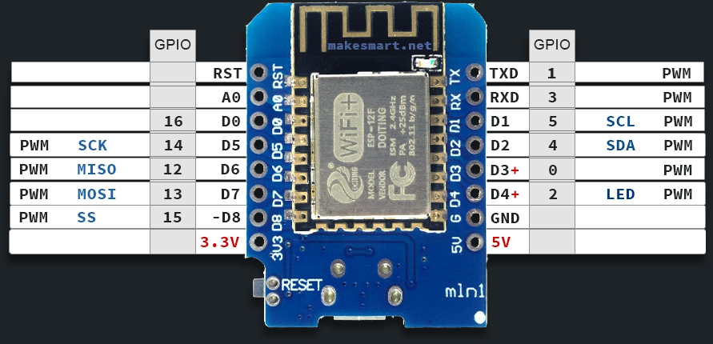
ESp8266
3,3V Vcc
80MHz – 160 MHz
2,4 GHz WLAN
4MB Flash
RX/TX fähig
ESP12-F
Daten RX/TX
VCC 3.3V

Slide 7
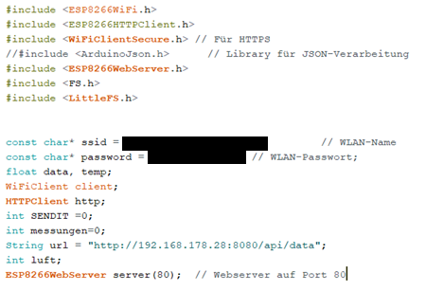
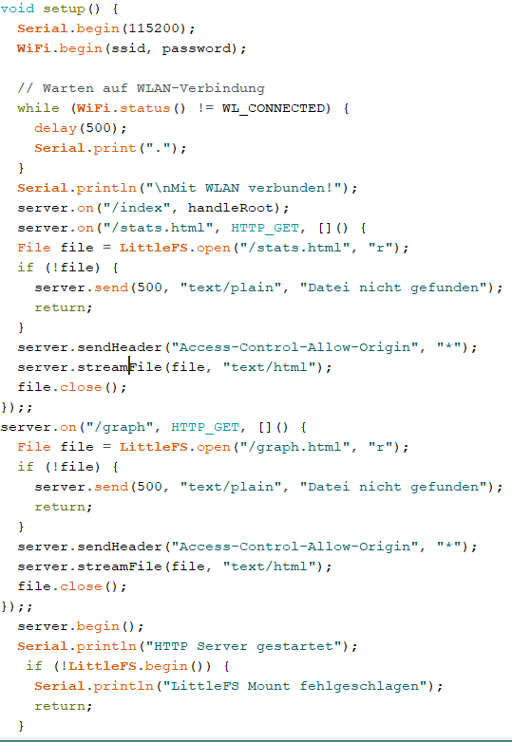
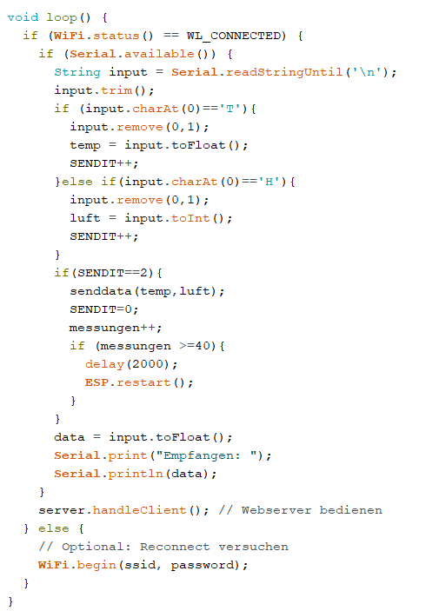
ESP8266
Notes:
void senddata(float temp, int luft){
http.begin(client,url); // deine Ziel-API
http.addHeader("Content-Type", "application/json");
String payload = "{";
payload += "\"temperature\":" + String(temp, 2) + ",";
payload += "\"luftfeuchte\":" + String(luft);
payload += "}";
int httpResponseCode = http.POST(payload);
Serial.print("Daten gesendet, Statuscode: ");
Serial.println(httpResponseCode);
http.end();
}

Slide 8
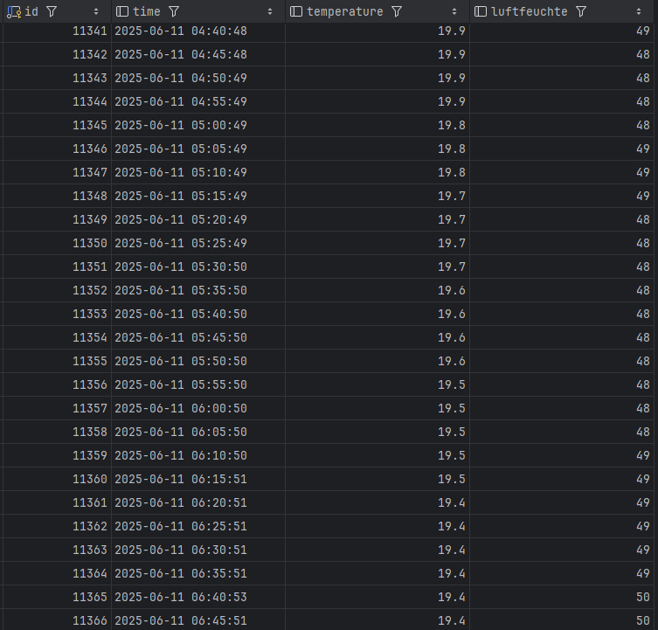
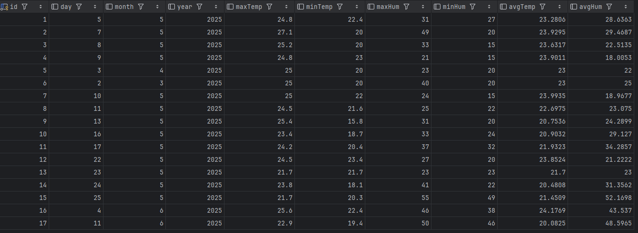
Datenbank
Datenbank in MariaDB
CREATE table weather_raw (
id INT not null auto_increment primary key,
time DATETIME,
temperature float,
luftfeuchte int
);
CREATE table weather_day
(
id INT not null auto_increment primary key,
day INT,
month INT,
year INT,
maxTemp float,
minTemp float,
maxHum INT,
minHum INT,
avgTemp float,
avgHum float
);
CREATE table weather_stats(
Id INT primary key,
anz INT,
avgTemp float,
avgHum float,
maxTemp float,
minTemp float,
maxHum INT,
minHum INT
);
DROP DATABASE if exists weather;
CREATE DATABASE if not exists weather;
USE weather;

Slide 9
API
[HttpPost("data")]
public async Task<IActionResult> PostData([FromBody] weather_raw data)
{
if (data == null)
{
return BadRequest("Die empfangenen Daten sind ungültig.");
}
if (data.luftfeuchte == 0 || data.temperature == 0)
{
return Ok(new { message = "Daten fehlerhaft", data });
}else
{
// Speichere neue Rohdaten
_context.weather_raw.Add(data);
await _context.SaveChangesAsync();
// Aktualisiere oder erstelle weather_day
var today = DateTime.Today;
var dayEntry = await _context.Set<weather_day>()
.FirstOrDefaultAsync(wd => wd.day == today.Day && wd.month == today.Month && wd.year == today.Year);
if (dayEntry == null)
{
dayEntry = new weather_day();
_context.Add(dayEntry);
}
// Aktualisiere Min/Max
dayEntry.maxTemp = Math.Max(dayEntry.maxTemp, data.temperature);
dayEntry.minTemp = Math.Min(dayEntry.minTemp, data.temperature);
dayEntry.maxHum = Math.Max(dayEntry.maxHum, data.luftfeuchte);
dayEntry.minHum = Math.Min(dayEntry.minHum, data.luftfeuchte);
// Berechne Durchschnittswerte neu
var allToday = await _context.weather_raw
.Where(w => w.time.Date == today)
.ToListAsync();
dayEntry.avgTemp = allToday.Average(w => w.temperature);
dayEntry.avgHum = (float) allToday.Average(w => w.luftfeuchte);
await _context.SaveChangesAsync();
// var stats = await _context.Set<weather_stats>().FirstOrDefaultAsync();
var stats = await _context.weather_stats.FindAsync(1);
if (stats ==null)
{
stats = new weather_stats{Id = 1};
_context.Add(stats);
}
var all = await _context.weather_raw.ToListAsync();
stats.anz = all.Count;
stats.maxTemp = all.Max(raw => raw.temperature);
stats.minTemp = all.Min(raw =>raw.temperature );
stats.maxHum = all.Max(raw =>raw.luftfeuchte ) ;
stats.minHum = all.Min(raw => raw.luftfeuchte);
stats.avgTemp = all.Average(raw => raw.temperature);
stats.avgHum = (float) all.Average(raw => raw.luftfeuchte);
await _context.SaveChangesAsync();
return Ok(new { message = "Daten gespeichert", data });
}
}

Slide 10
APi
[HttpGet("getdata")]
public async Task<IActionResult> GetData()
{
var data = await _context.weather_raw
.OrderBy(raw =>raw.Id )
.LastOrDefaultAsync();
return Ok(new
{
temp = data.temperature,
luft = data.luftfeuchte
});
}
[HttpGet("stats")]
public async Task<IActionResult> Getstats()
{
var data = await _context.weather_stats.FindAsync(1);
Console.WriteLine("Eigentlich sollen hier stats sein: "+ data.anz);
return Ok(new
{
anz = data.anz,
tavg = data.avgTemp,
tmax = data.maxTemp,
tmin = data.minTemp,
havg = data.avgHum,
hmax = data.maxHum,
hmin = data.minHum
});
}
[HttpGet("monthly-averages")]
public async Task<IActionResult> GetMonthlyAverages()
{
var data = await _context.weather_day
.GroupBy(w => new { w.month, w.year })
.Select(g => new {
Month = g.Key.month,
Year = g.Key.year,
AvgTemp = g.Average(w => w.avgTemp),
AvgHum = g.Average(w => w.avgHum)
})
.OrderBy(g => g.Year).ThenBy(g => g.Month)
.ToListAsync();
return Ok(data);
}
[HttpGet("day-minmax")]
public async Task<IActionResult> GetTodayMinMax()
{
var today = DateTime.Today;
var entry = await _context.weather_day
.FirstOrDefaultAsync(w =>
w.day == today.Day &&
w.month == today.Month &&
w.year == today.Year);
if (entry == null)
{
return NotFound(new { message = "Keine Daten für heute gefunden." });
}
return Ok(new
{
Date = $"{entry.day}.{entry.month}.{entry.year}",
MinTemp = entry.minTemp,
MaxTemp = entry.maxTemp,
MinHum = entry.minHum,
MaxHum = entry.maxHum
});
}

Slide 11
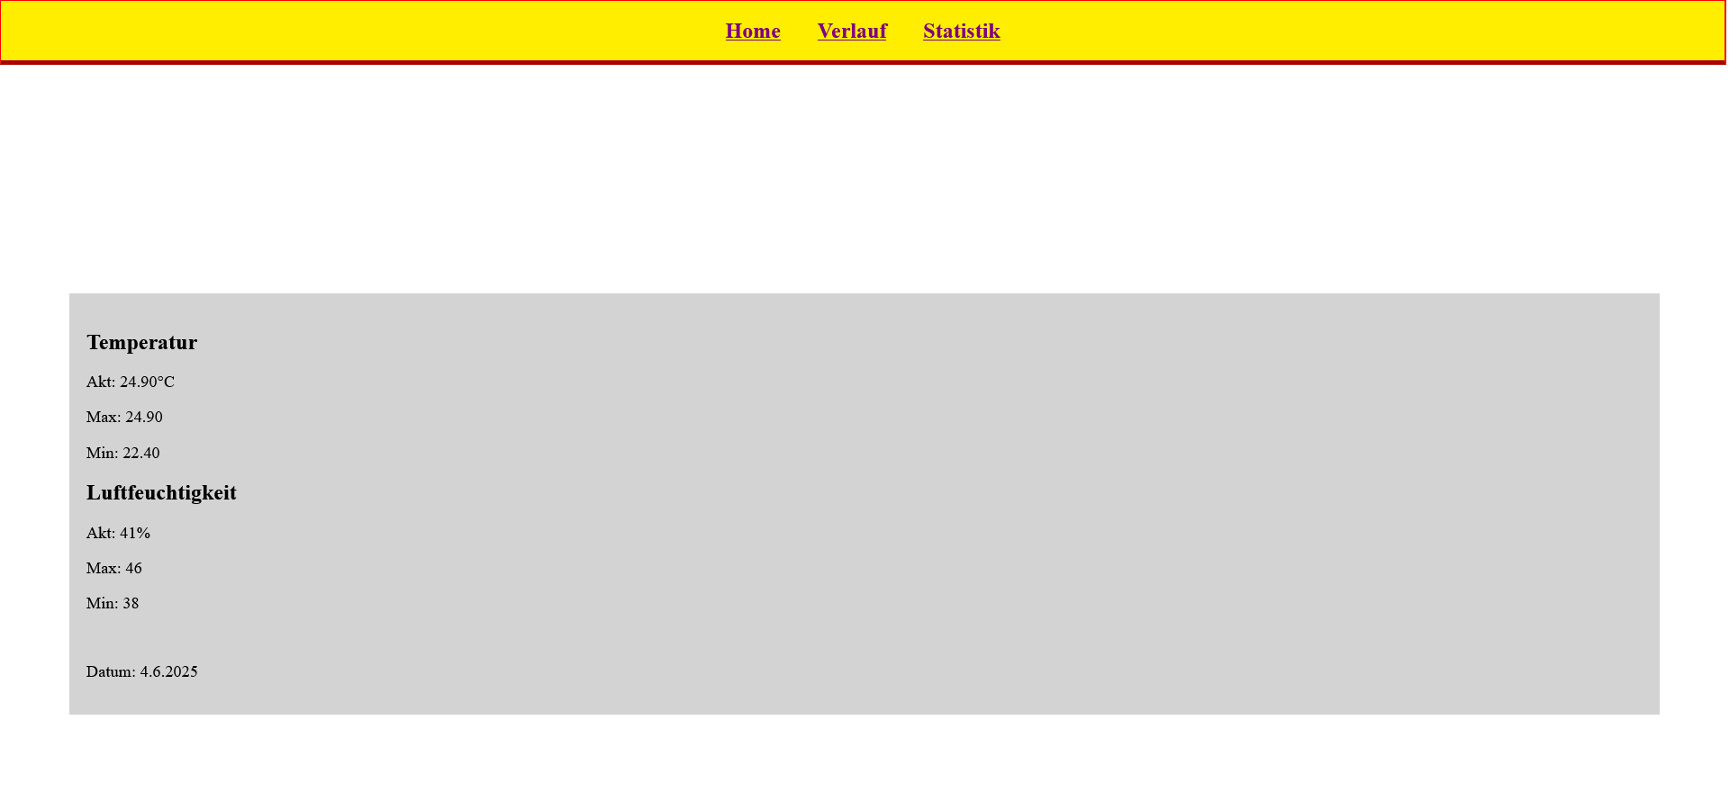
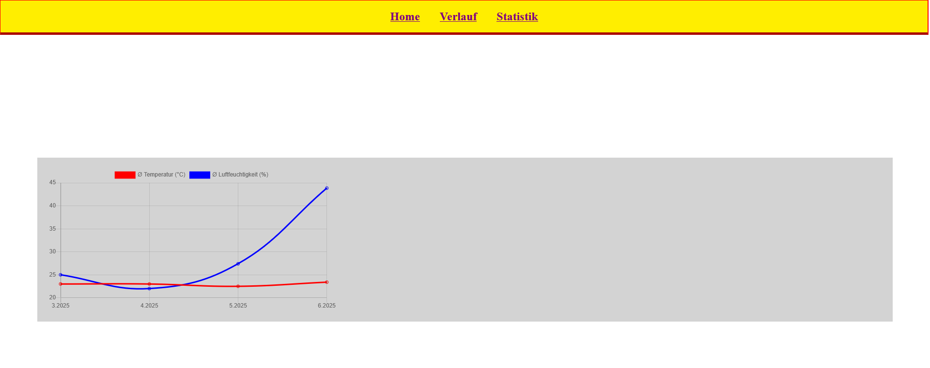
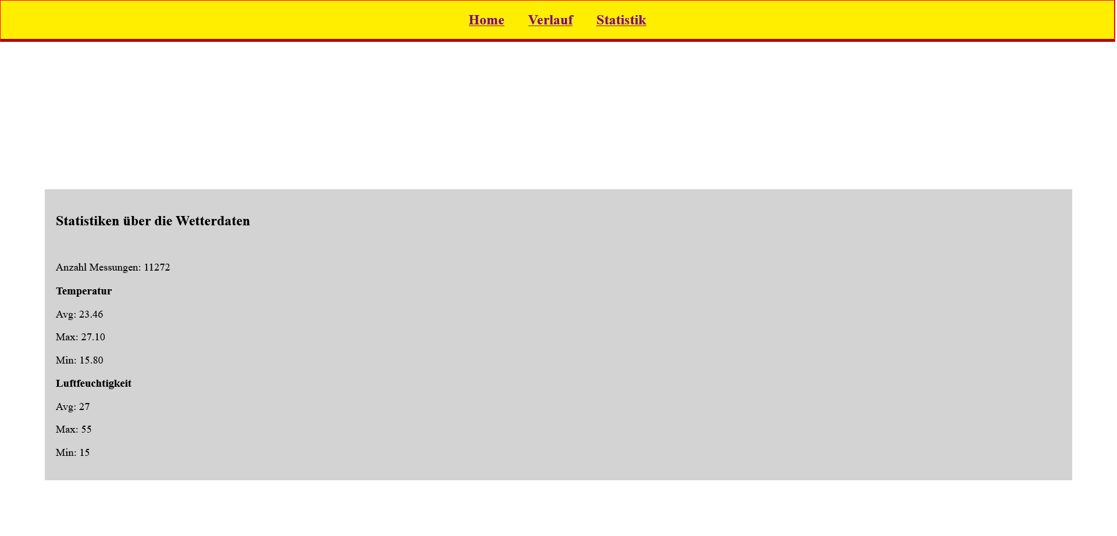
Webseite

Slide 12
Webseite
<script>
async function ladeDaten() {
try {
// Aktuelle Messwerte
const resAkt = await fetch('http://192.168.178.28:8080/api/getdata');
const jsonAkt = await resAkt.json();
const temp = parseFloat(jsonAkt.temp);
const luft = parseFloat(jsonAkt.luft);
document.getElementById("t_cur").textContent = "Akt: " + temp.toFixed(2) + "°C";
document.getElementById("h_cur").textContent = "Akt: " + luft.toFixed(0) + "%";
// Min/Max des Tages vom Server
const resMinMax = await fetch('http://192.168.178.28:8080/api/day-minmax');
const jsonminxmax = await resMinMax.json();
document.getElementById("t_max").textContent = "Max: " + jsonminxmax.maxTemp.toFixed(2);
document.getElementById("t_min").textContent = "Min: " + jsonminxmax.minTemp.toFixed(2);
document.getElementById("h_max").textContent = "Max: " + jsonminxmax.maxHum.toFixed(0);
document.getElementById("h_min").textContent = "Min: " + jsonminxmax.minHum.toFixed(0);
document.getElementById("day").textContent = "Datum: " + jsonminxmax.date;
} catch (err) {
console.error("Fehler beim Laden:", err);
}
}
setInterval(ladeDaten, 10000); // Alle 10 Sekunden neu laden
ladeDaten(); // Sofort beim Start
</script>
</body>
<body>
<div id="header">
<a href="/index"><strong>Home</strong></a>
<title> Wetterstation Garb </title>
<a href="/graph"><strong>Verlauf</strong></a>
<a href="/stats.html"><strong>Statistik</strong></a>
</div>
<div id="main">
<h2>Temperatur</h2>
<p id="t_cur">Akt: XX.XX°C</p>
<p id="t_max">Max: --</p>
<p id="t_min">Min: --</p>
<h2>Luftfeuchtigkeit</h2>
<p id="h_cur">Akt: XX.XX%</p>
<p id="h_max">Max: --</p>
<p id="h_min">Min: --</p>
<br>
<p id="day"> Today: --</p>
</div>
Notes:
new Chart('myChart', {
type: 'line',
data: {
labels: labels,
datasets: [
{
label: 'Ø Temperatur (°C)',
data: temps,
borderColor: 'red',
fill: false
},
{
label: 'Ø Luftfeuchtigkeit (%)',
data: hums,
borderColor: 'blue',
fill: false
}
]
},
options: {
responsive: true,
plugins: {
legend: { position: 'top' },
title: { display: true, text: 'Monatliche Durchschnittswerte' }
}
}
});

